Slide 2
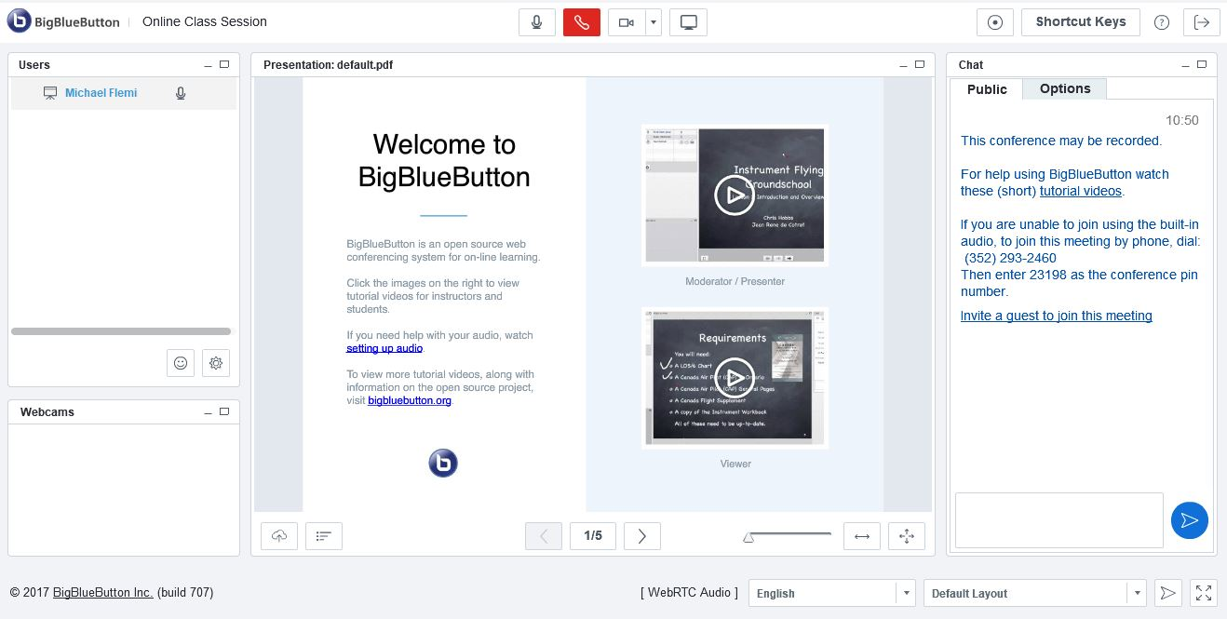
Conferences Presenter Training

Slide 3
Agenda
How to schedule a meeting
Meeting layout
Audio & webcam setup
How attendees can participate
Recording
Uploading a presentation
Public and private chat
Managing participants
Troubleshooting

Slide 4
How to schedule your meeting
Course site
Conferences

Slide 5
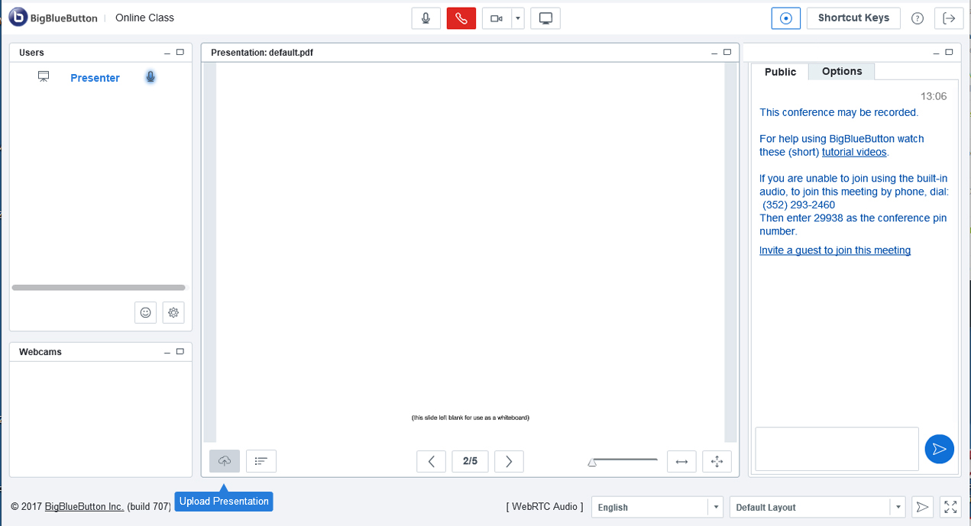
Meeting layout

Slide 6
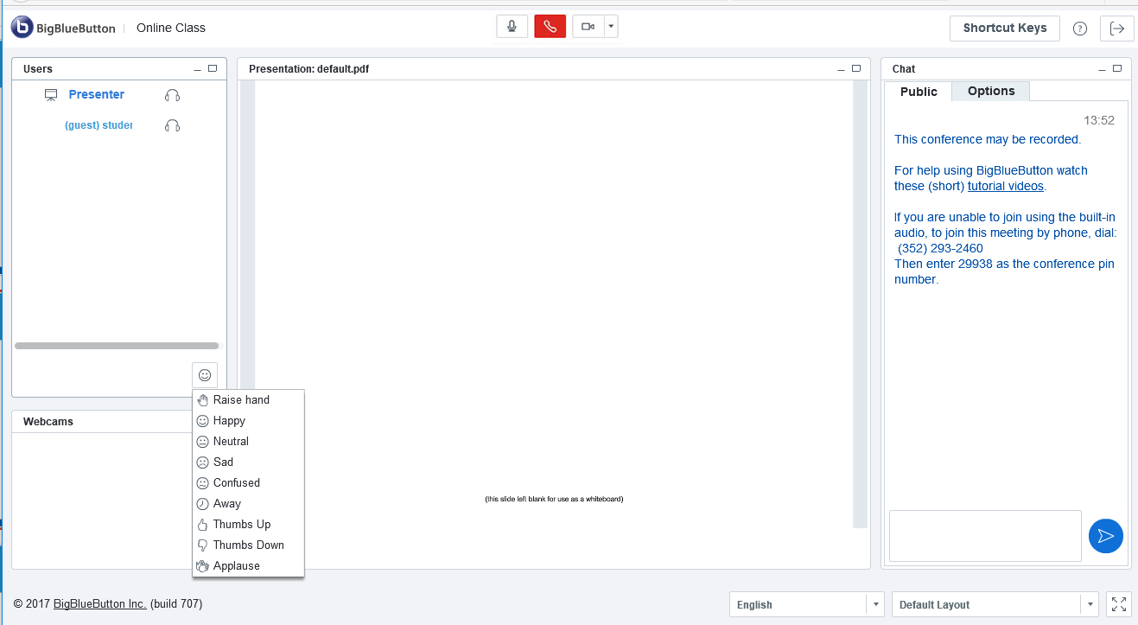
How can attendees participate?
Raise hand & use status changes
Mute/unmute microphone
Start/Stop webcam
Public chat (private chat under Options)

Slide 7
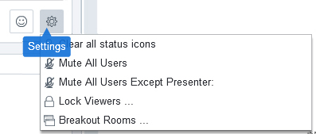
Breakout Rooms

Slide 8
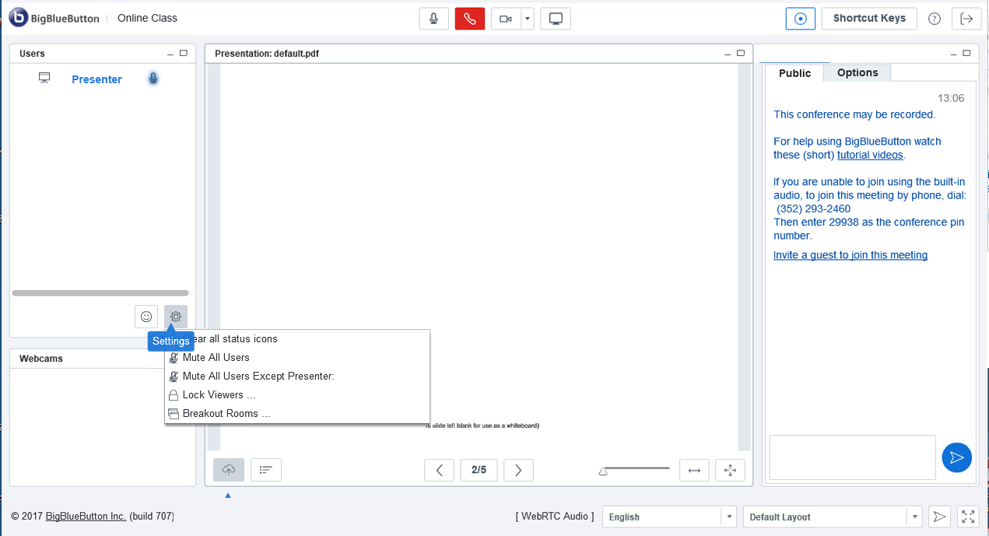
Click on Settings
Presenter access to user controls

Slide 9
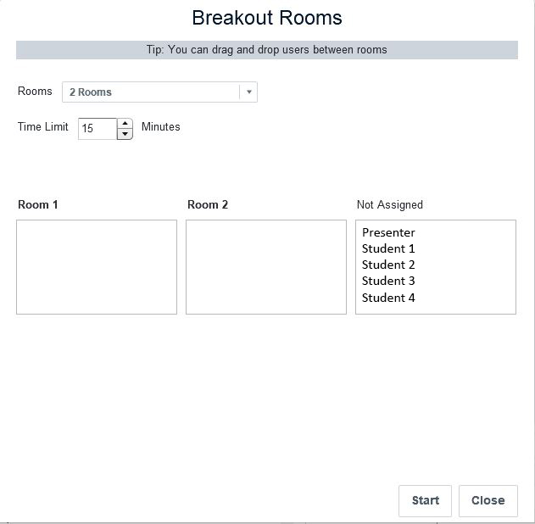
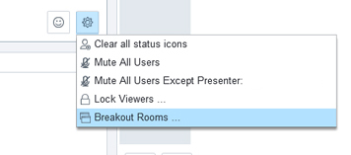
How to start breakout rooms
Select “Breakout Rooms”
Set # rooms and time limit
Drag and drop

Slide 10
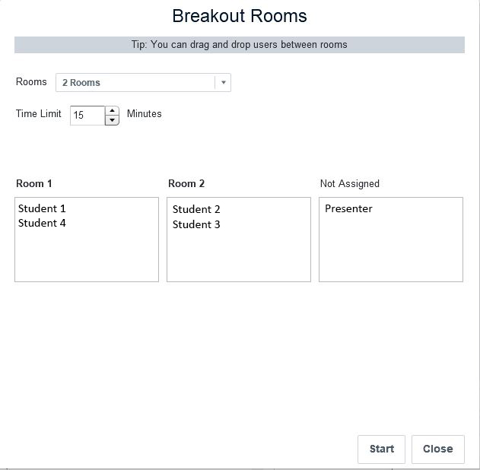
How to start breakout rooms
Tip:
You can create up to 5 breakout rooms and organize participants accordingly. Participants must click “Join Session” when they see the pop-up appear for their breakout room.
After assigning all participants, click Start

Slide 11
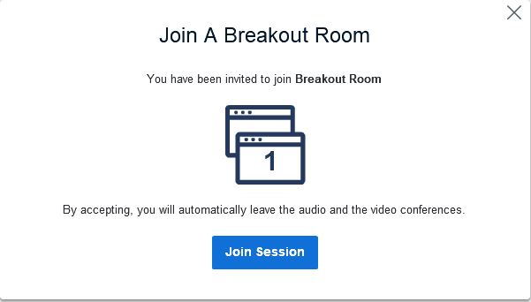
What participants see

Slide 12
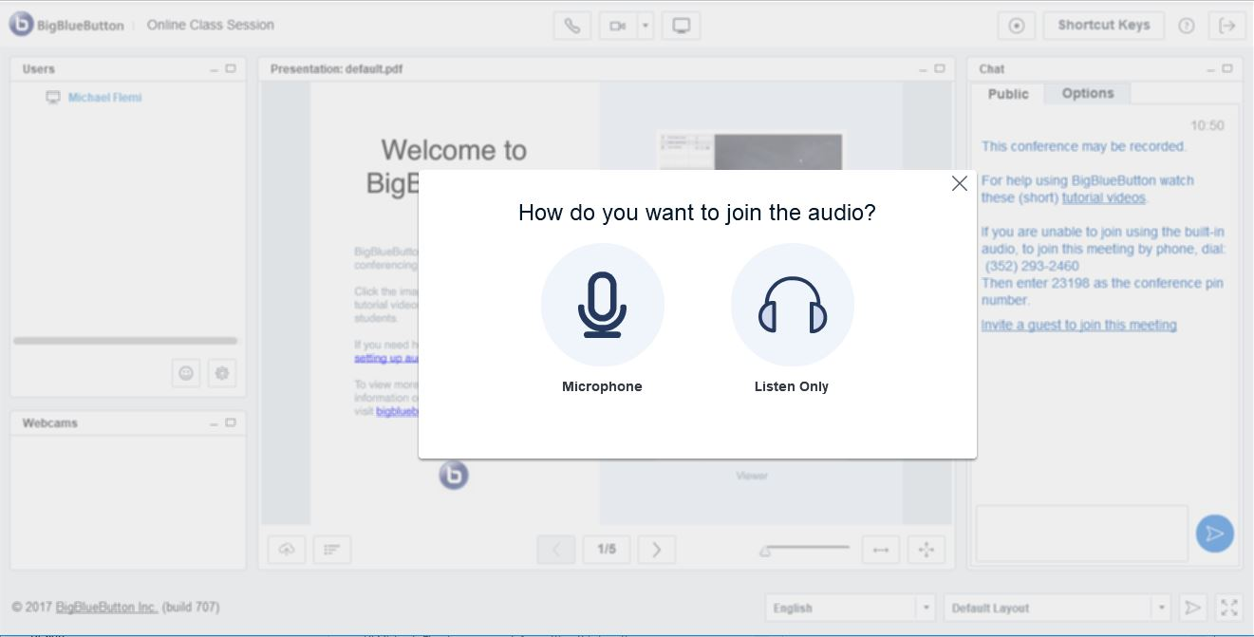
What participants see
Tip:
Participants will be prompted to re-join audio whenever they enter a room (breakout room and main meeting room)

Slide 13
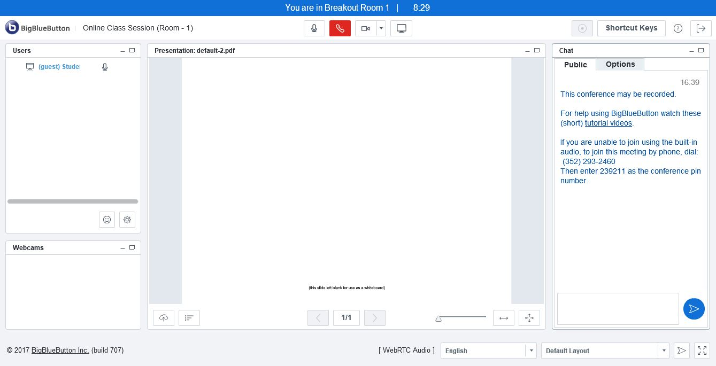
What participants see

Slide 14
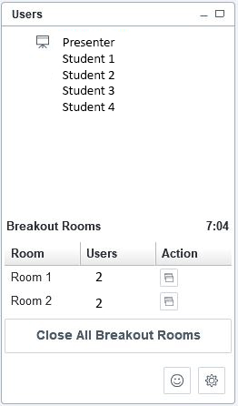
What the presenter sees
Click on this icon to join a breakout room
Click here to end breakouts before the time limit
Change breakout assignments

Slide 15
The End

