Slide 2
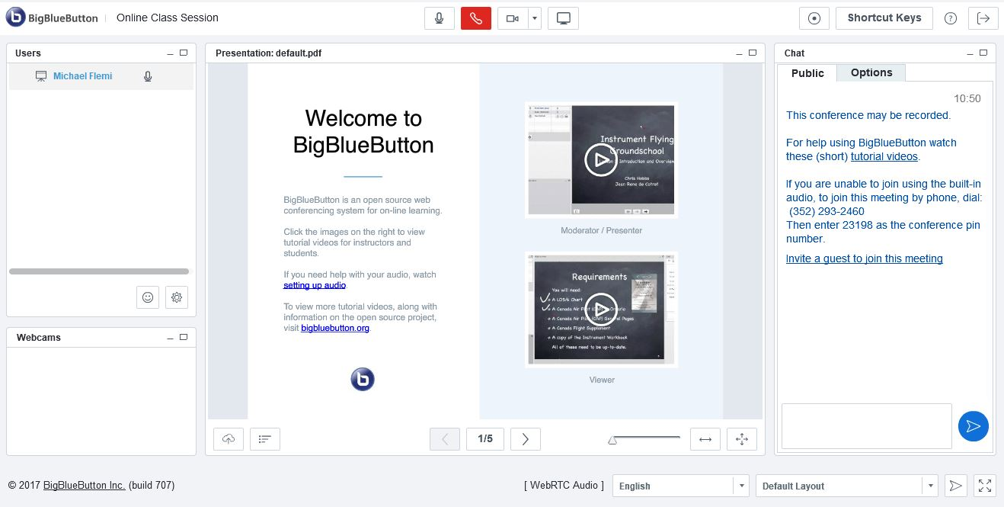
Conferences Presenter Training

Slide 3
Agenda
How to schedule a meeting
Meeting layout
Audio & webcam setup
How attendees can participate
Recording
Uploading a presentation
Public and private chat
Managing participants
Troubleshooting

Slide 4
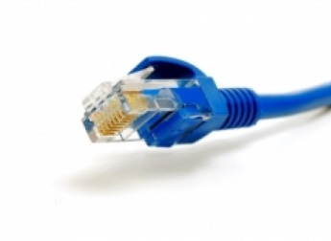
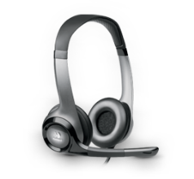
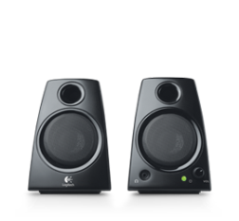
Best Practice Tips Before We Begin…
We recommend: Because:
A hard-wired connection
Poor wifi causes:
choppy audio
disconnection
The Firefox browser
Chrome causes occasional performance issues
A headset or headphones
Using computer
speakers causes
echo

Slide 5
How to Schedule a Meeting
Course site
Conferences

Slide 6
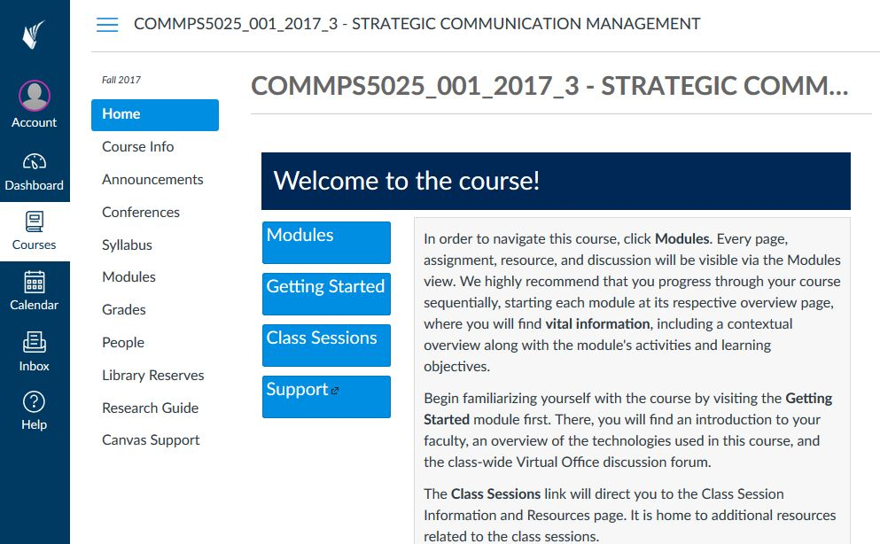
Click on Conferences in Your Course Site
Choose your course
Click on Conferences
Tip:
If you do not see Conferences, follow these instructions to activate it in course “Settings”

Slide 7
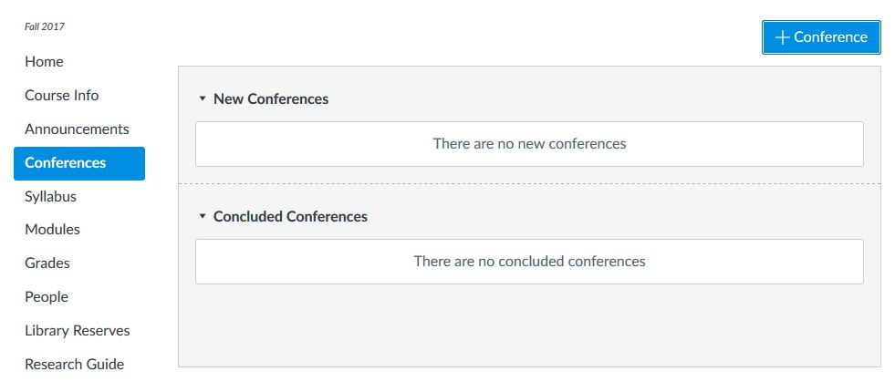
Schedule and Start a New Conference
Click +Conference

Slide 8
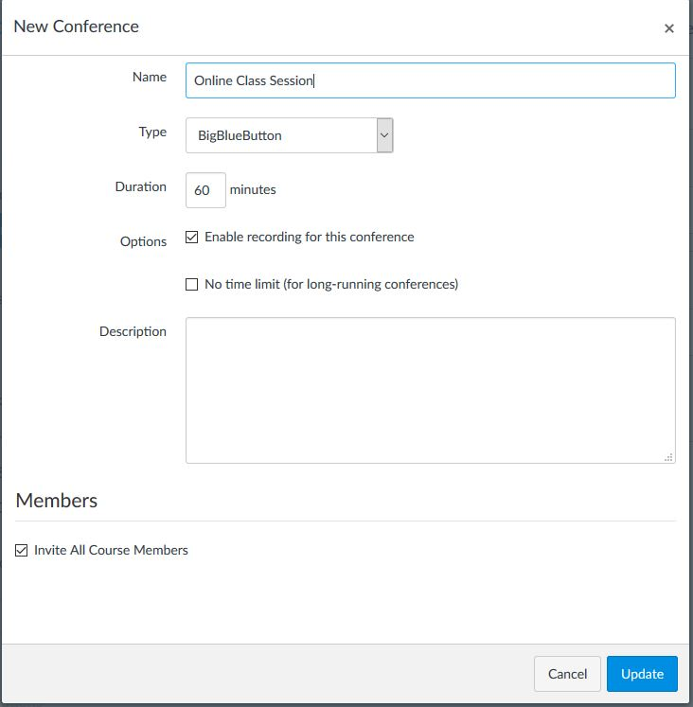
Enter Conference Information
Add a meeting title
Tip:
If you do not select “Enable recording” you will not be able to record in your meeting!

Slide 9
Set Time, Invite Users, Update
The Conference will automatically conclude if you set a time limit. Click “no time limit” to avoid this.
ALL course members will be invited by default. Uncheck this box to select users, or invite no one to test out the interface.
Tip:
Users get an email alert as soon as you click Update.

Slide 10
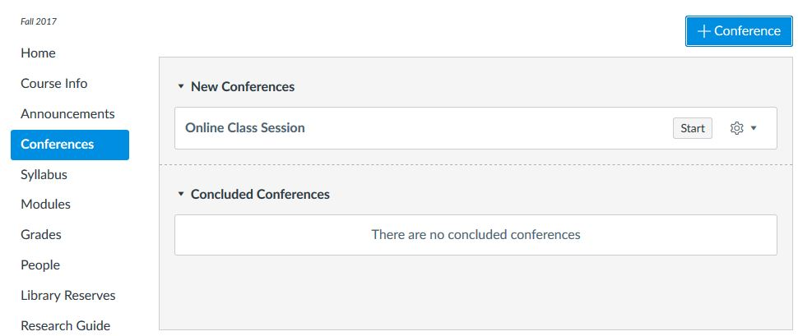
Click Start to Begin the Meeting
Click Start to begin or gear icon to edit

Slide 11
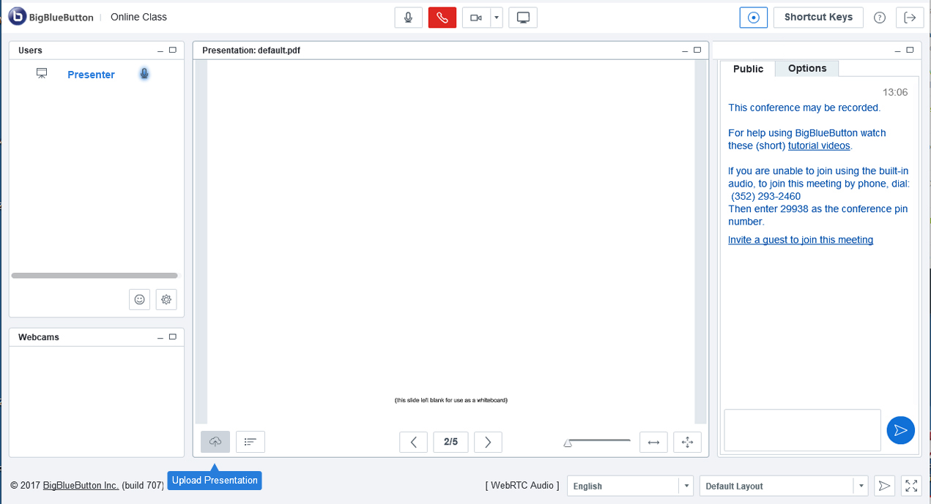
Meeting Layout

Slide 12
Meeting Layout
Users
Presentation
Chat
Webcams

Slide 13
Meeting Layout
Tip:
Be sure to force the layout for all users if you want participants to see the same thing that you see after changing a conference layout.
The presenter can change layouts using this drop-down here

Slide 14
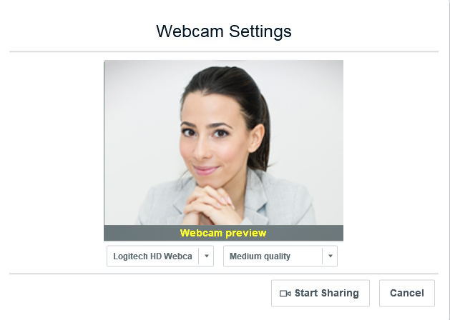
Connect to Audio & Webcam

Slide 15
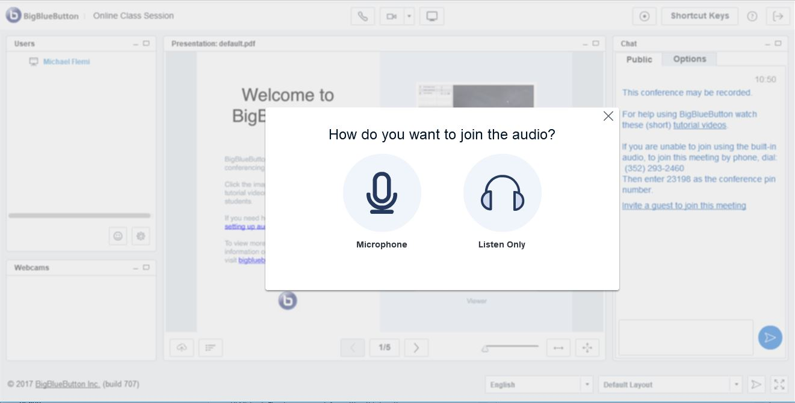
Audio Setup
When you first log in, you will see this pop-up
Click “Microphone” to turn on your mic

Slide 16
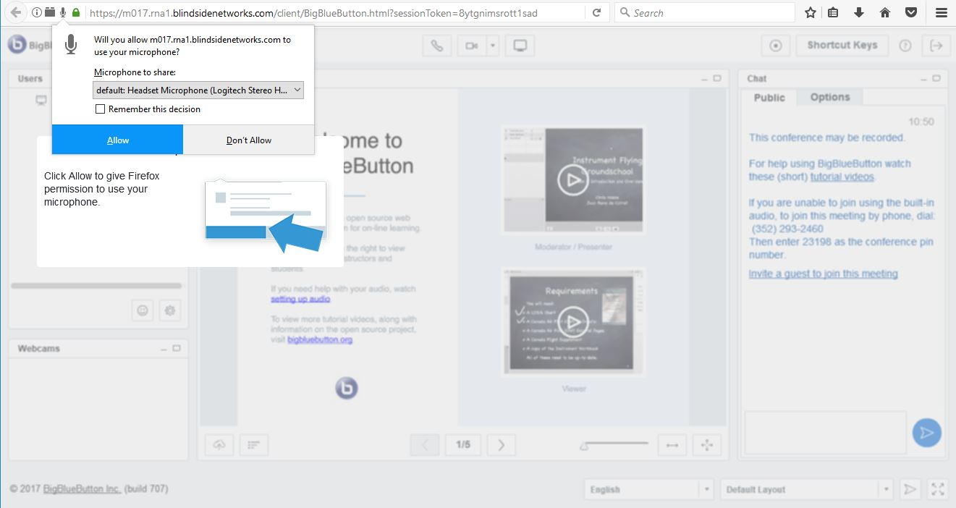
Allow Access to Microphone
Click Allow
Tip:
If you do not see this pop-up you can always click on the mic icon near the address bar to change permissions.
Notes:
In the first step, you test your sound output (make sure sound is coming though your headset speakers).

Slide 17
Audio Test
Test your microphone and if you can hear yourself click “Yes”
Notes:
In the first step, you test your sound output (make sure sound is coming though your headset speakers).

Slide 18
How to Activate Webcam
Click on the webcam icon at the top of your screen
Adjust settings and when you are ready click
“Start Sharing”

Slide 19
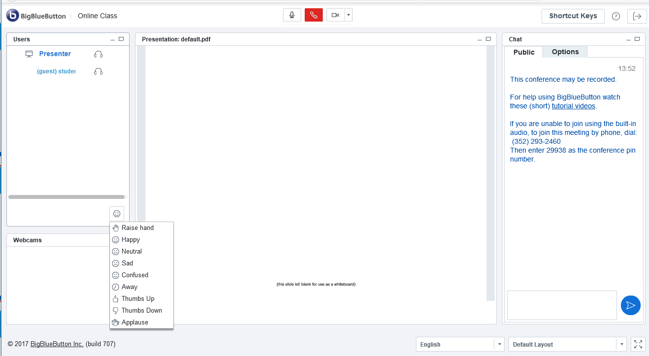
How Can Attendees Participate?
Raise hand & use status changes
Mute/unmute microphone
Start/Stop webcam
Public chat (private chat under Options)

Slide 20
User Roles in BigBlueButton
Presenter can:
Participants can:
Layout
Content
&
Roles
and add or edit layouts and add or edit layouts
View content
Change meeting layout
Upload presentations
Pass Presenter rights
Record meetings
Start breakouts
Screen share
Share screen
View screen share
Video
Broadcast video
Broadcast video
Audio
Broadcast audio
Mute others
Broadcast audio
Chat
Chat
Chat
Notes:
As a meeting Host, you have control over all aspects of the Adobe Connect meeting room.
Hosts can set up a meeting, add/share content, create polls, and add or edit layouts in a meeting room. They can promote other participants to the role of meeting room host or presenter, or give enhanced permissions to a participant without promoting the participant. They can also start and stop recording within a meeting room. Hosts are able to create and manage small group breakout rooms within a meeting. They can also perform all the tasks that a presenter or participant can.
Presenters cannot edit layouts or move pods, but they are able to share content already loaded into the meeting room from the library and share content from their computer. They can share their screen with all attendees, chat, and broadcast live audio and video.
Participants can view the content that the presenter is sharing, hear and see the presenter’s audio and video broadcast, and use text chat.

Slide 21
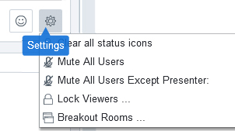
Presenter Controls

Slide 22
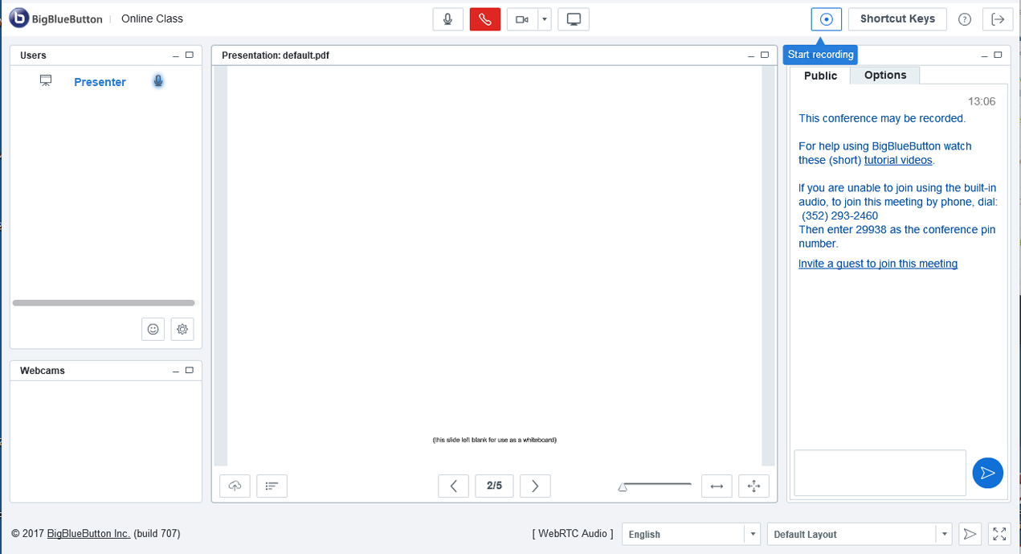
How to Record
Click the Recording button to start and stop recording
Tip:
Remember, if you did not select “Enable recording” when scheduling your conference you will not be able to record in your meeting!

Slide 23
How to Upload a Presentation
Tip:
Remember, only the Presenter can see this option. If you are not the presenter, you will not see the upload icon in the lower left.
Click the Upload icon to upload or change your presentation

Slide 24
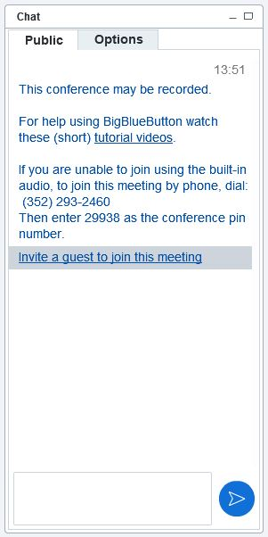
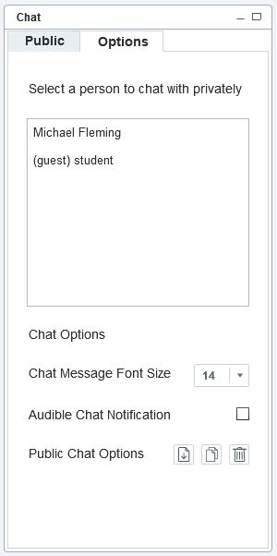
How to Chat
Public Chat is the default. Click “Options” for private chat.
Tip:
Presenters can also invite guests to join a meeting by clicking on the “Invite a guest to join this meeting” link in the chat panel.

Slide 25
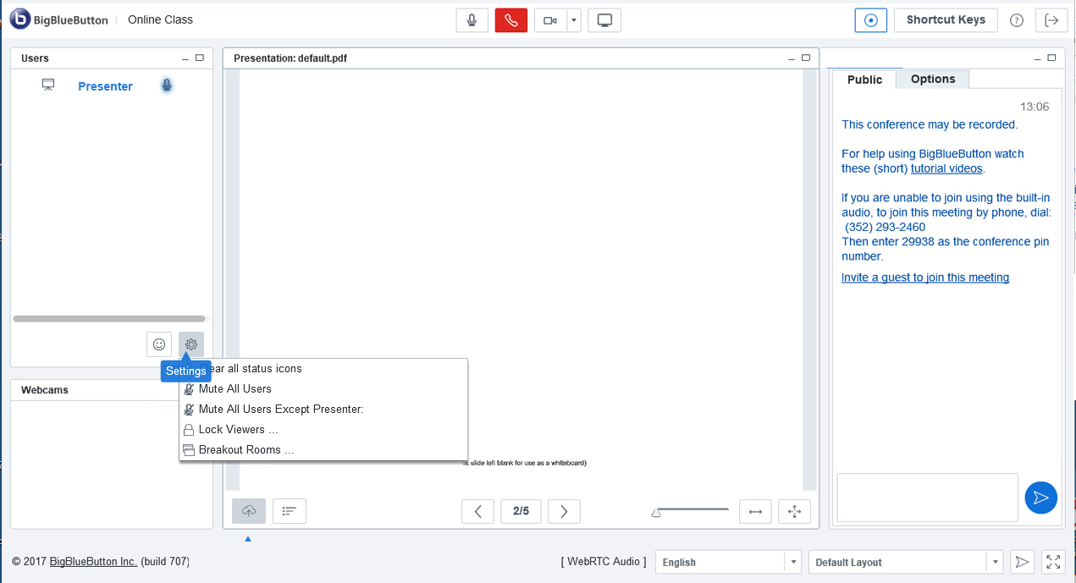
How to Manage Participants
Click the gear icon in the Users panel to access presenter controls and manage participants.
Tip:
Breakout Rooms can also be found under these user settings. This is where you can break up your meeting into smaller group meetings.

Slide 26
View Recordings
Recordings will auto-generate when you leave a Conference and appear underneath the Conference title

Slide 27
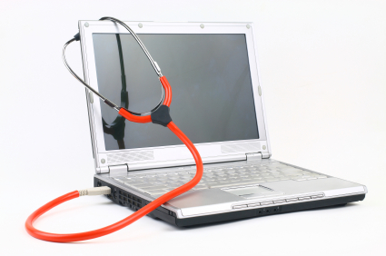
Need Help?
Watch BBB
Video tutorials
Visit Canvas User Guides
Instructors & Students
Submit a Request
Cusps.zendesk.com

Slide 28
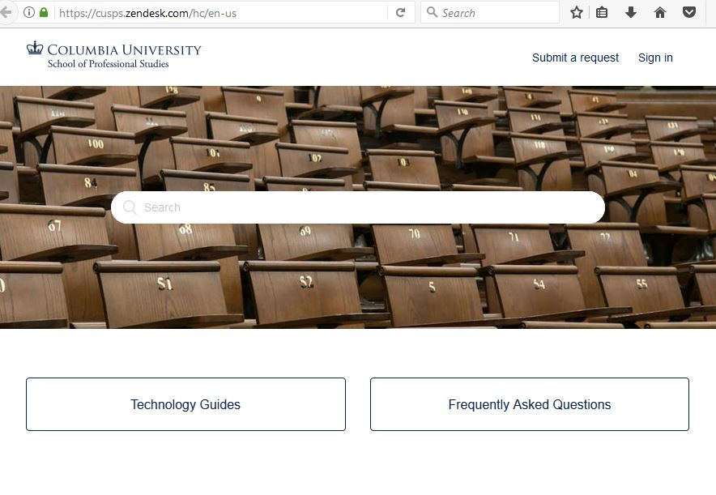
Submit a Helpdesk Request

Slide 29
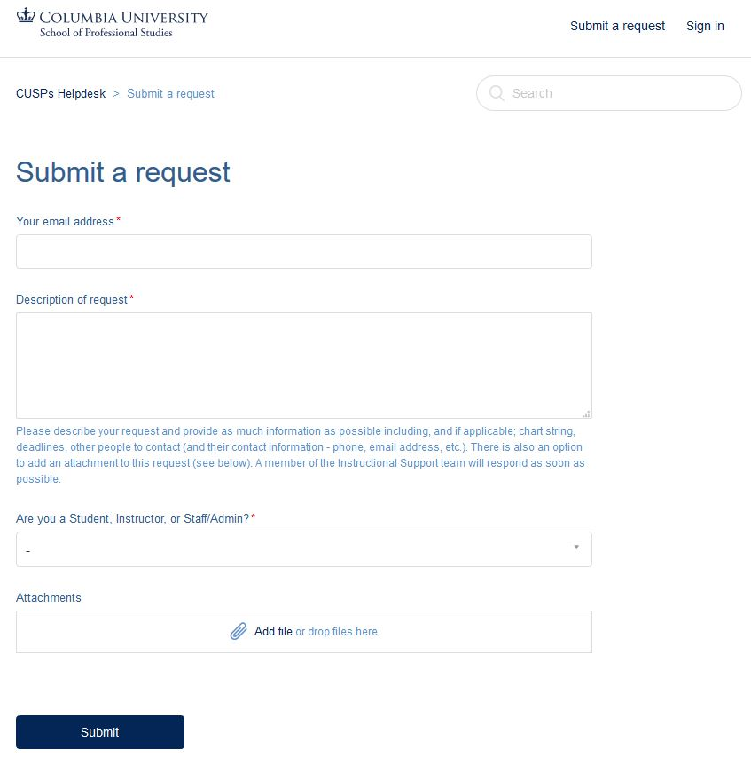
Submit a Helpdesk Request

Slide 30
The End

