Slide 2
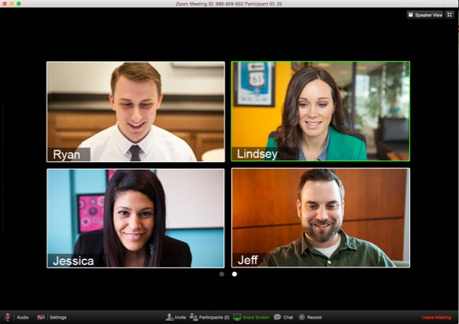
Zoom Host Training Fall 2018
Notes:
What is Zoom?
Zoom is a cloud-based HD video-conferencing tool. Zoom allows for the instructor and students to meet in real-time via webcam and audio. Instructors can screen share content during their lecture or invite students on mic and webcam for discussion. Zoom allows for participation via features like raise hand, chat, audio, and in some classes polling questions and breakouts.
Zoom offers:
Ease of use: Download Zoom, join your meeting, turn on your mic and webcam
Quality: Zoom allows for HD webcam video, clear Audio, and crisp Screen Share
Stability: The bandwidth used by Zoom will be optimized for the best experience based on the participants’ network. It will automatically adjust for 3G, WiFi or Wired environments.

Slide 3
Agenda
What is Zoom?
How to join a meeting
Audio & video setup
Host controls
Manage participants
Meeting Settings
Chat & participation
Polls and Breakouts
Questions

Slide 4
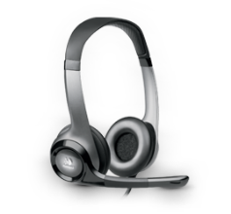
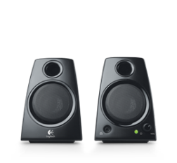
Best practice tips before we begin…
We recommend: Because:
A hard-wired connection
Poor wifi causes:
choppy audio
disconnection
A modern web browser
Out of date
browsers may cause performance issues
A headset or headphones
Using computer
speakers may
cause echo
Notes:
Zoom works well on wifi because it optimizes performance based on the user’s network. However, as the main Host for the meeting it is best to be connected via Ethernet to prevent any performance issues.
It is best to use a supported operating system and modern web browser when hosting a Zoom meeting. Supported browsers include: Firefox, Chrome, Safari5+, and IE7+
Always use a headset when in a Zoom meeting to avoid audio feedback. Otherwise, other people in the meeting will experience a strong echo when you speak (you will not necessarily hear it but others will).

Slide 5
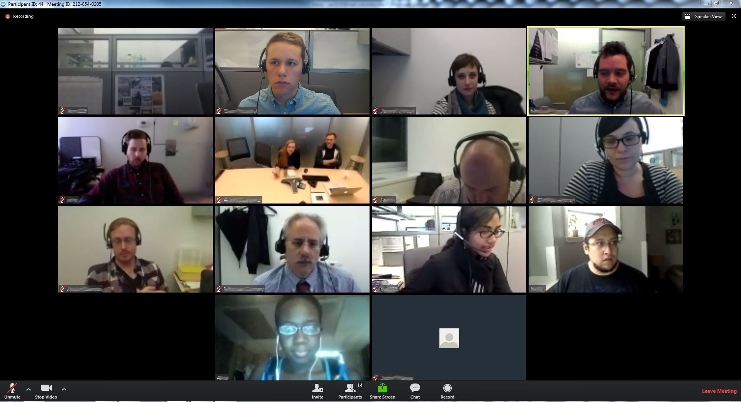
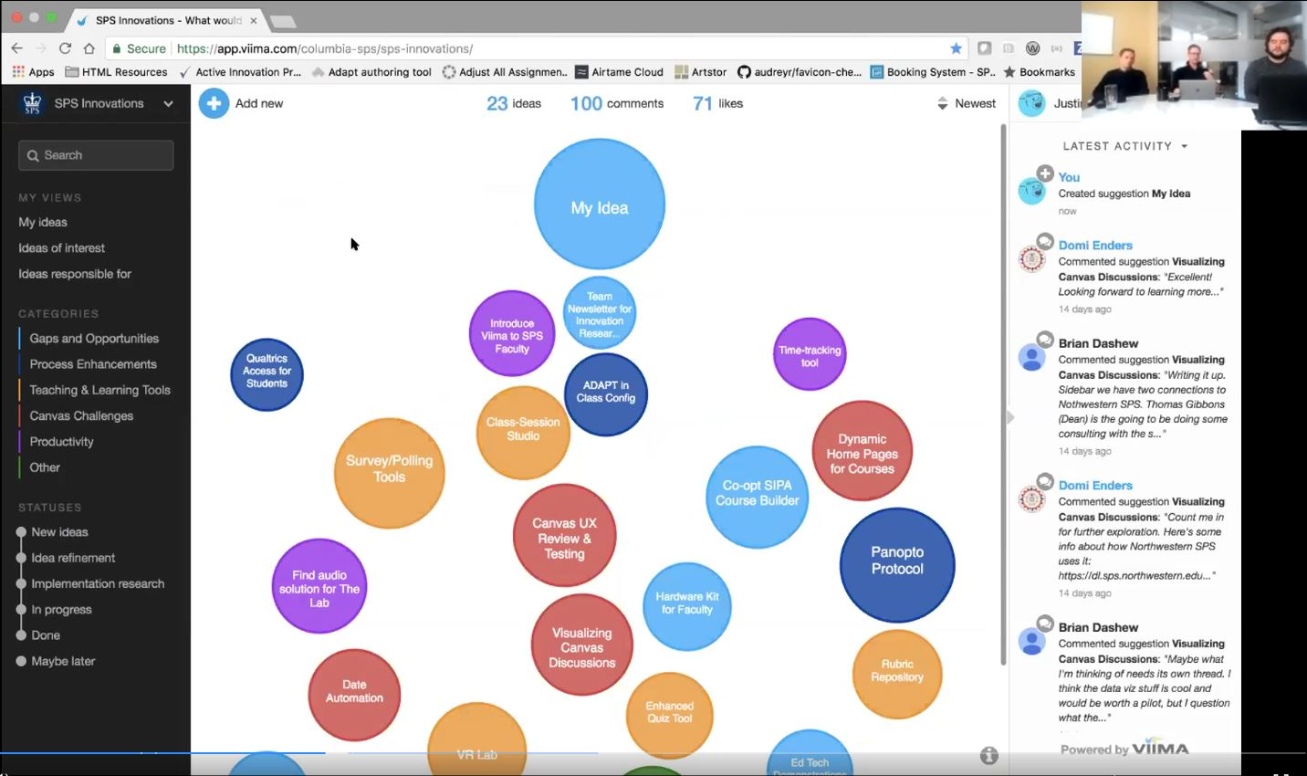
What is Zoom?
Zoom is a cloud-based HD video conferencing platform with a wide range of functionalities. Zoom allows faculty and students to meet in real-time via webcam and audio for online class sessions, office hours, and informal virtual meetings. The tool has essential features that enhance the online class experience like screen share, cloud recording, group chat, and breakout rooms.
Notes:
What is this tool? Explained for an audience of Faculty and Students

Slide 6
Basic vs. Pro Zoom account
What is the difference between a Basic user and a Pro user?
Zoom has a “freemium” business model where users can sign up for a basic account at no cost before deciding to upgrade and pay for more advanced features. A Basic user is a free account and a Pro user is a paid account with advanced features. A Basic user can still schedule, host, and record meetings, but with some limitations:
There is a limit of 40-minutes per meeting
Local recording is the only recording option
Breakout rooms are available, but co-host option is not
Polling and some other advanced settings are not available

Slide 7
Basic vs. Pro Zoom account
Basic
Pro:
Account overview
Free account you can access at any time
and add or edit layouts and add or edit layouts
Granted during semesters when faculty are teaching online classes with
live sessions
Log in:
Log in with your personal email
Log in with your Columbia UNI
and password
Tip:
If you are teaching required online class sessions this term, we will create a Zoom Pro account for you. No need to sign up on your own.
Class sessions:
Never use your basic account for your online class sessions.
Always use your Pro account for your online class sessions.
Notes:
*
Take out line about signing up up on their own? Main message – I don’t want everyone to go sign up for a free account after this training.

Slide 8
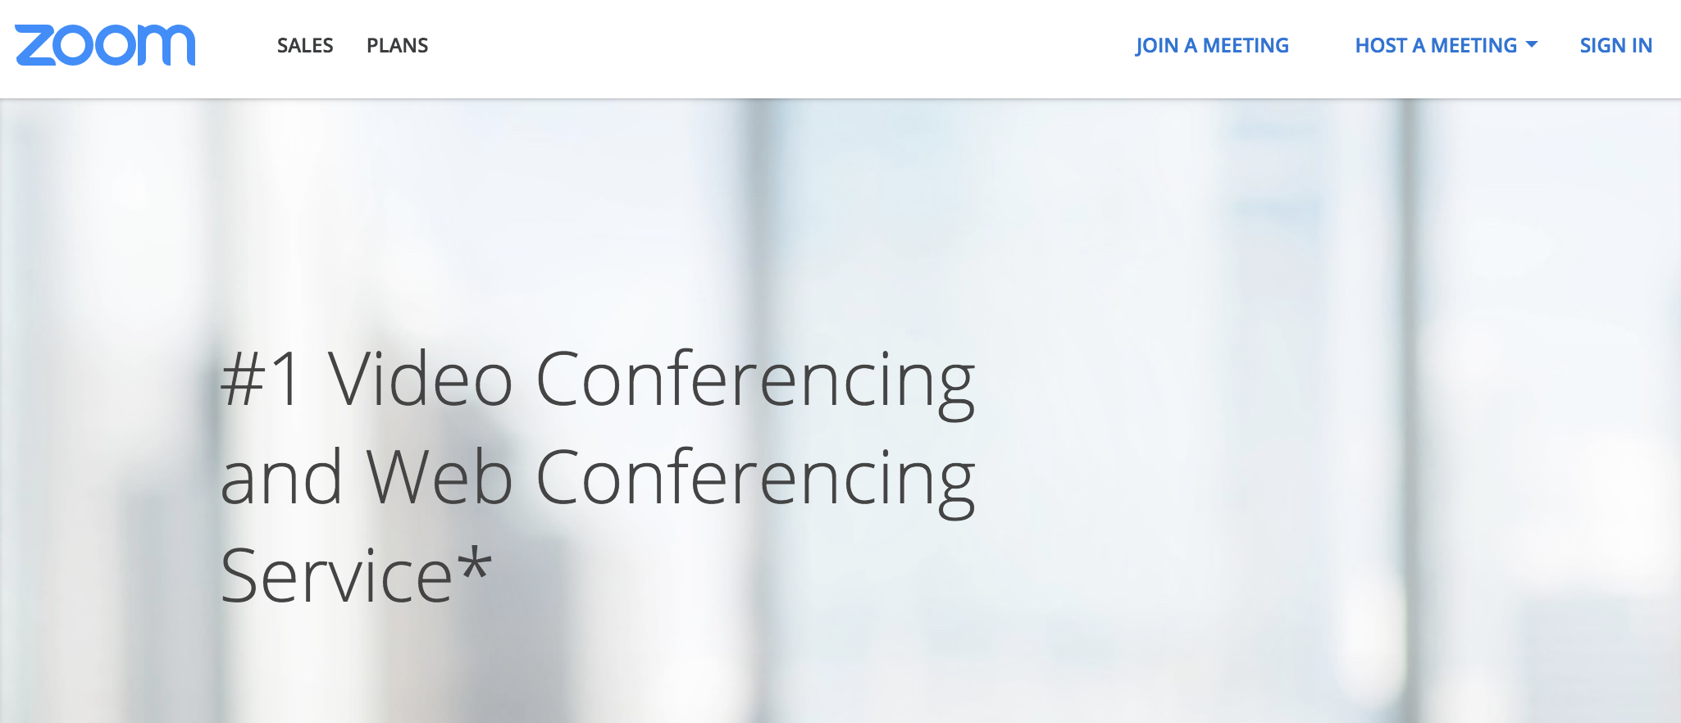
Signing in to your Zoom Pro Account
To use your Zoom Pro Account, you must sign in on the Columbia University Zoom home page:
https://columbiauniversity.zoom.us
When you click SIGN IN on the upper right, you will be sent to an authentication page where you can enter your UNI and password.
Step 1:
SIGN IN to Zoom
Tip:
Always use your Columbia UNI and Password to sign in.
Notes:
*
Note – once you get an email about it from Michael
Also note to tell attendees – Zoom works as a program you download, but you also access your settings, features, and log in on the columbiauniversity.zoom.us website

Slide 9
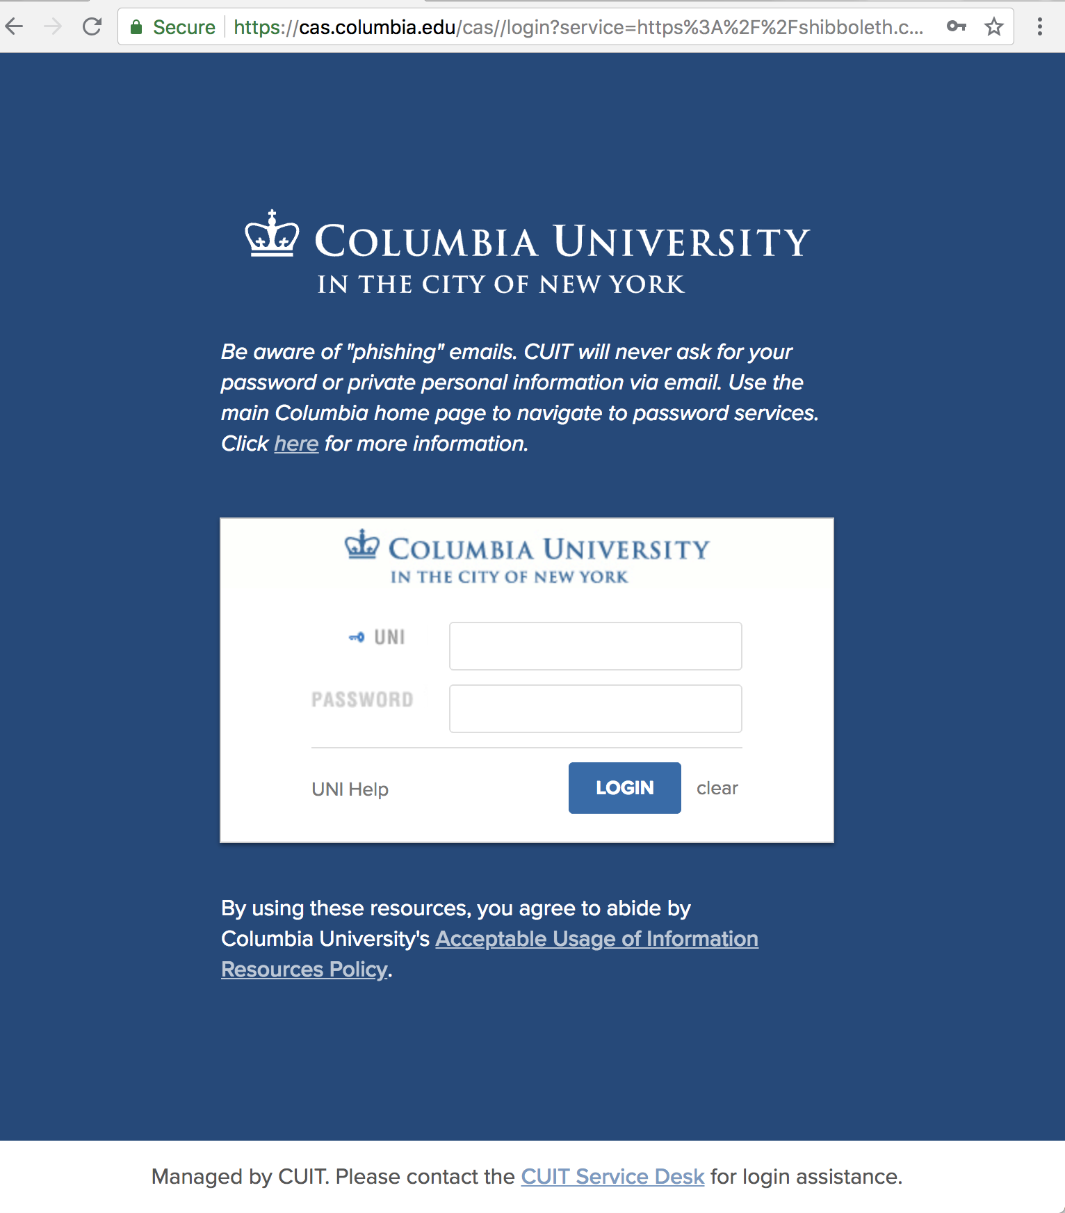
Signing in to your Zoom Pro Account
When you are routed to the authentication page, enter your Columbia UNI and your Columbia password.
Avoid entering information from other email accounts on this page (such as a non-Columbia Gmail account), as your Pro Account is associated with your Columbia UNI, email, and Password only.
Step 2:
Enter your UNI and password and click “LOGIN”

Slide 10
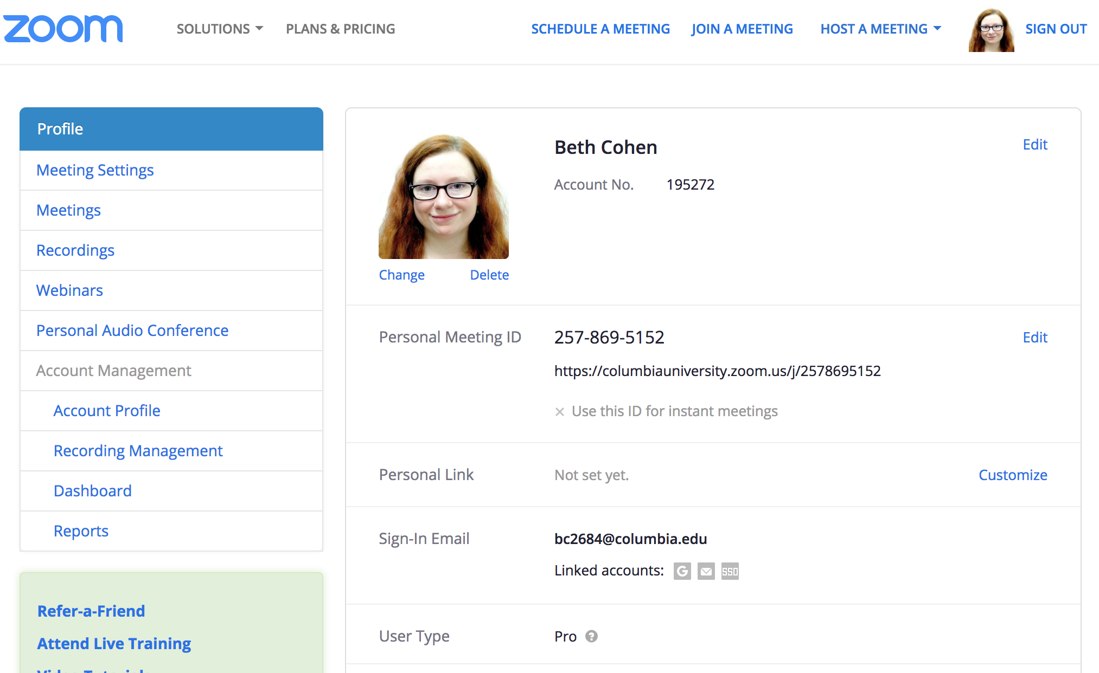
Your Zoom Pro Account Profile Page
On your Zoom profile page, you will see your personal meeting ID, meeting url, and your Sign-In Email. Your Sign-In Email will be your Columbia email address. You will also see a Personal Link, which is a custom URL students will use to join your classes.
When you run a meeting using your Pro Account, you will be the Host of the meeting and have all host rights and controls.
Personal ID and URL
XXX-XXX-XXXX
XXX-XXX-XXXX
Columbia Email
Notes:
*
Note – Please confirm that this slide is correct and that everyone will have a custom URL (for people who have Pro accounts through us) using this convention.

Slide 11
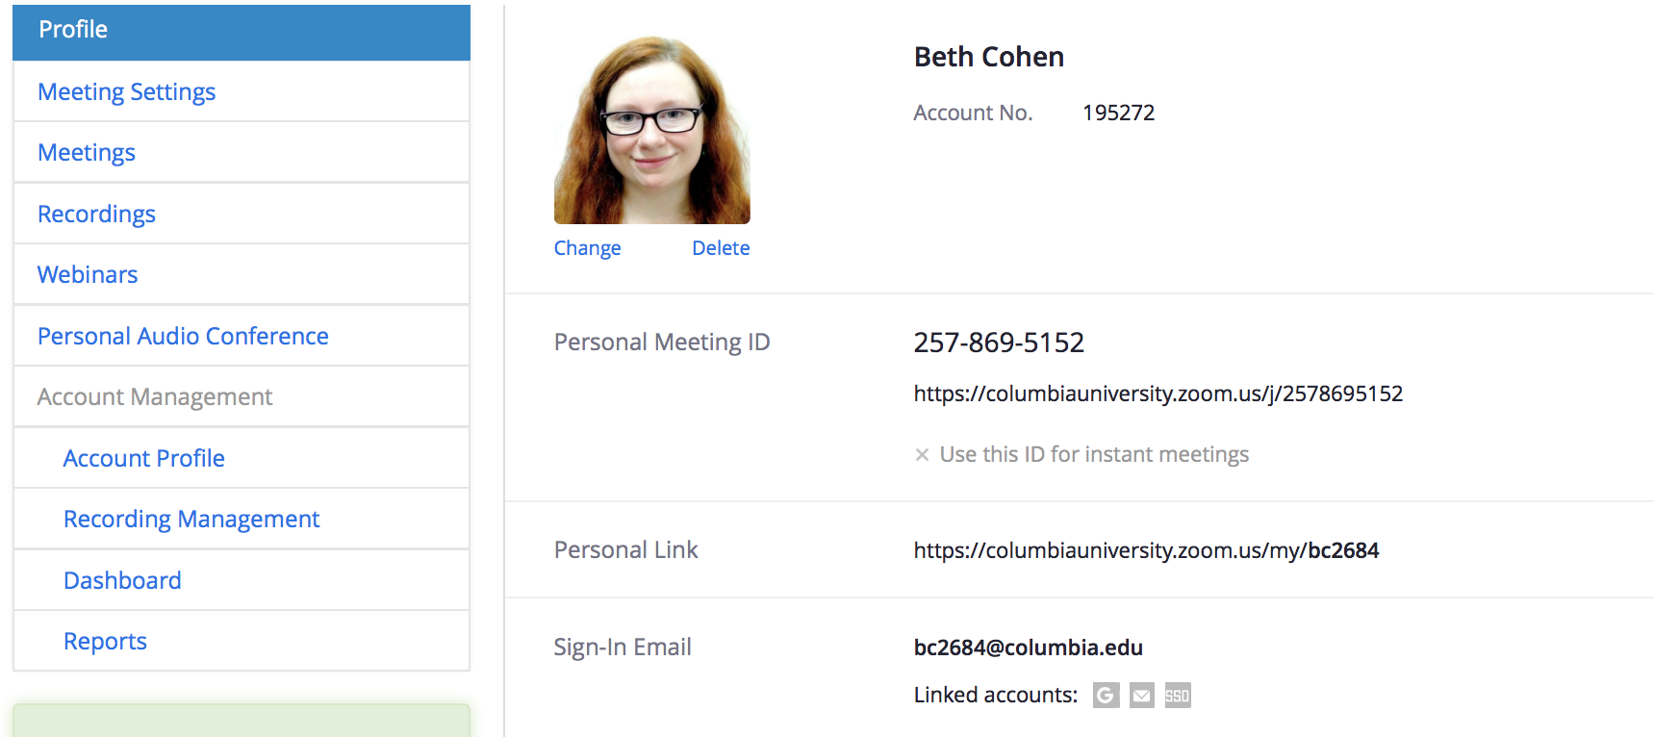
Your Personal Link/Custom URL
When you have a Pro Account through SPS, you will be given a personalized Custom URL that includes your UNI. This is the URL your students will always use to join your classes. It will be posted on your course’s Class Sessions page.
XXX-XX-XXXX
Custom URL
Notes:
*
Note – Please confirm that this slide is correct and that everyone will have a custom URL (for people who have Pro accounts through us) using this convention.
To tell attendees – if you have a basic account, account through CUIT, or some other non-SPS account this may not hold true as we don’t have the same access to your account.

Slide 12
How to start a meeting
There are two ways of starting a meeting in Zoom. One is through scheduled meetings with randomly generated meeting links and the other is through a personal meeting room with a persistent URL.
We recommend: For:
Personal Meeting Room
Weekly Online Class Sessions (persistent link )
Scheduled Meetings
One-off meetings
Office Hours
Recitations
Notes:
Zoom works well on wifi because it optimizes performance based on the user’s network. However, as the main Host for the meeting it is best to be connected via Ethernet to prevent any performance issues.
It is best to use a supported operating system and modern web browser when hosting a Zoom meeting. Supported browsers include: Firefox, Chrome, Safari5+, and IE7+
Always use a headset when in a Zoom meeting to avoid audio feedback. Otherwise, other people in the meeting will experience a strong echo when you speak (you will not necessarily hear it but others will).

Slide 13
Option 1: Personal Meeting Room

Slide 14
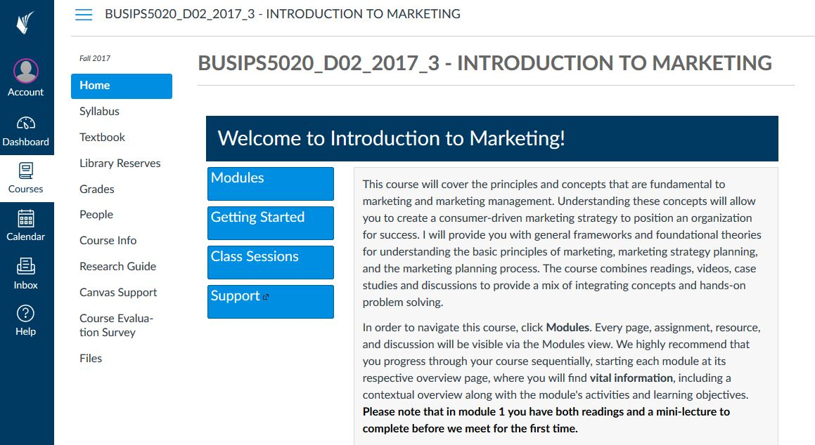
Option 1: From your Canvas course page click on Class Sessions
Choose your course
Click on Class Sessions

Slide 15
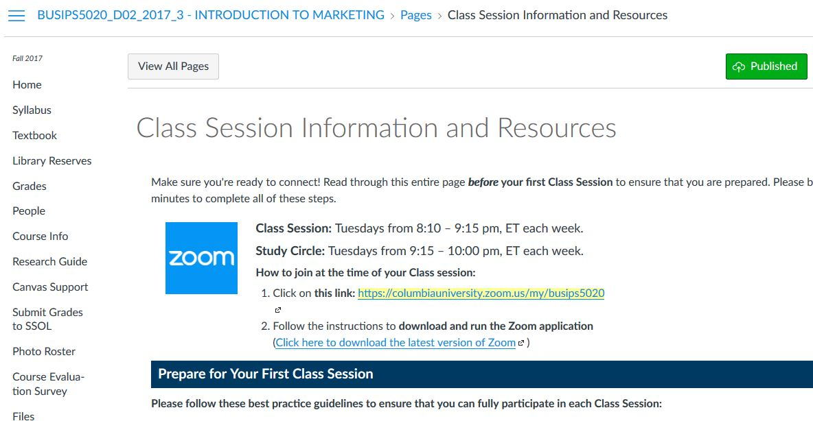
Option 1: Click the URL for your Personal Zoom meeting
Join Zoom Meeting
Tip:
This is a persistent link that students can join for each session, however you will need to be logged in as Host*.
Sign in here to ensure you have Host rights*:
https://columbiauniversity.zoom.us
(Enter UNI and Password)

Slide 16
Option 2: Schedule a meeting

Slide 17
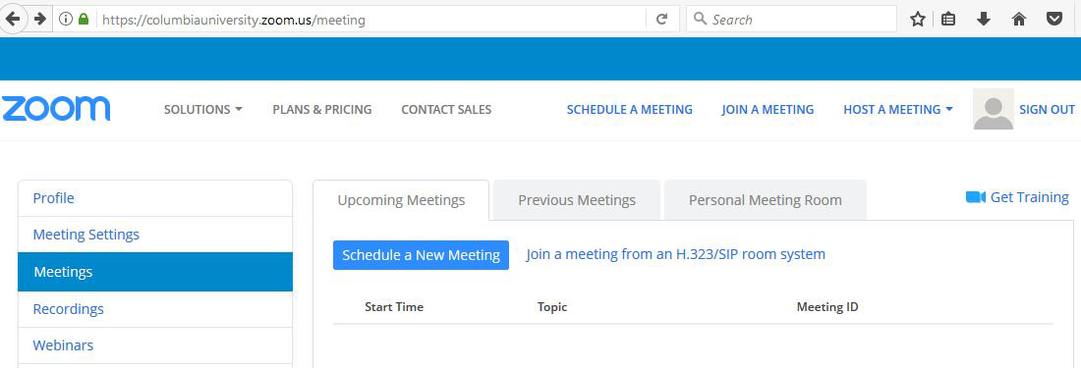
Option 2: Scheduling a Zoom meeting
SIGN IN to Zoom
https://columbiauniversity.zoom.us
(Enter UNI and Password)
Click on Meetings> Schedule a New Meeting

Slide 18
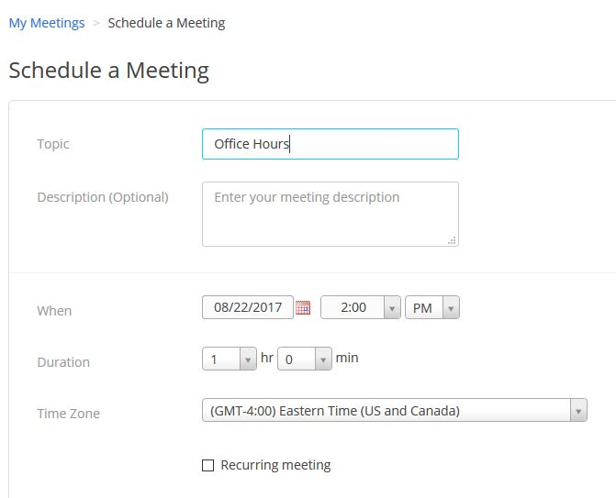
Option 2: Scheduling a Zoom meeting
Enter meeting information
Set the Date/Time and Duration
Click Save

Slide 19
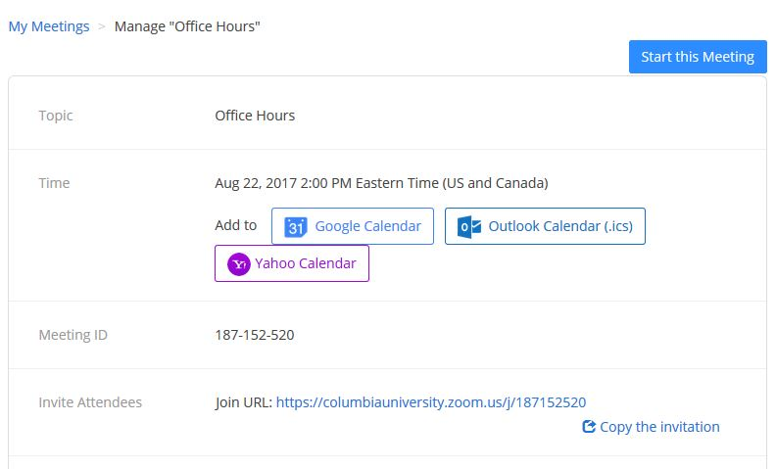
Option 2: Scheduling a Zoom meeting
2. At the time of the meeting click “Start the Meeting”
Tip:
Remember that scheduled meetings will create a randomly generated URL that you will need to share to attendees each time.
1. Share URL with attendees

Slide 20
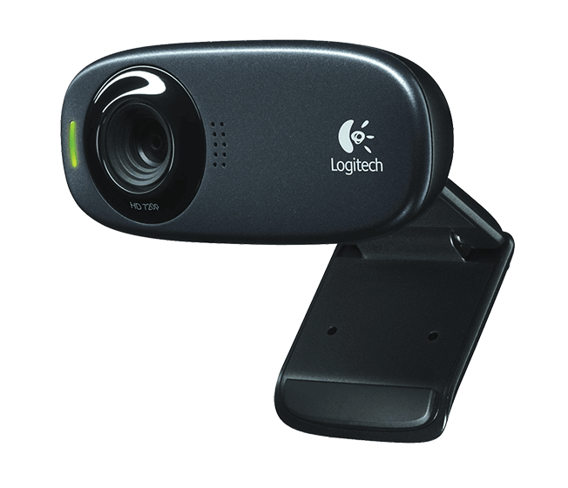
How to set up your audio & video

Slide 21
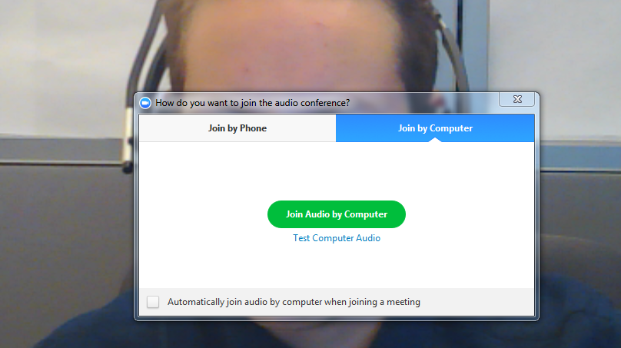
Activate your Microphone
Once you enter your meeting you will see this pop-up appear:
Click to Join or Test your Computer Audio

Slide 22
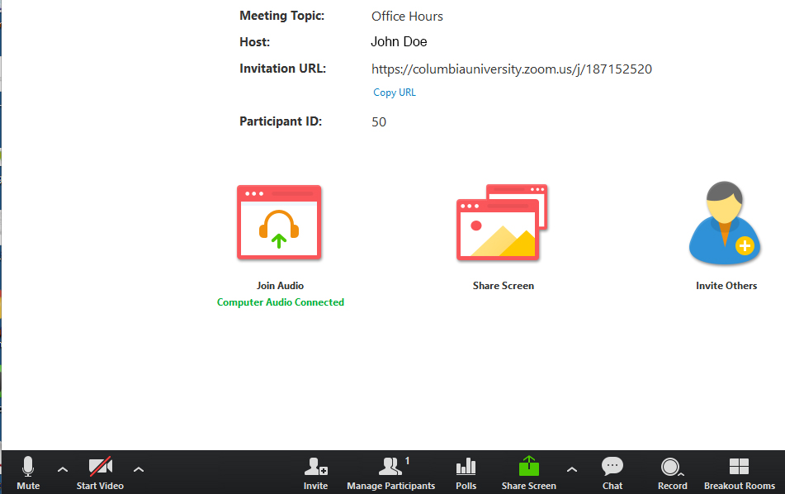
Activate your Webcam
Your webcam should activate automatically, but if it does not then you can click on the Video icon in the lower left of your screen:
Click
“Start Video”

Slide 23
Host controls
Notes:
Verbally note: No matter what account type you have, you will always automatically be the host of meetings held in your meeting room. This means that you must sign in to your Zoom meeting room to start classes or other meetings.

Slide 24
The three role types in Zoom:
Hosts can:
Co-hosts can:
Participants can:
and add or edit layouts and add or edit layouts
Be promoted by a Host under participant list
Manage participants
Record meetings
Role Permissions
Invite participants Manage participants
Change Meeting Settings
Create Breakouts & Polls
Record meetings End the meeting
and add or edit layouts and add or edit layouts
View webcams in gallery or speaker view
View screen share
Record with permission
Screen share
Share screen
Share screen
Share screen with permission
Video
Broadcast video
Broadcast video
Broadcast video
Audio
Broadcast audio
Mute others
Broadcast audio
Broadcast audio with permission
Chat
Chat
Chat
Chat

Slide 25
Host controls
Mute/Unmute your microphone
Turn on/off video
Invite other participants
Manage Participants
Share Screen (you may also grant others screen share rights)
Chat with all in meeting or privately with individuals
Record (you may also grant others recording rights)
Breakout Session (must be activated on Host’s account)
Tip:
You can adjust your audio or video by clicking the ^ up arrow and selecting “Audio Options/ Video Settings”

Slide 26
Manage Meeting and Participants

Slide 27
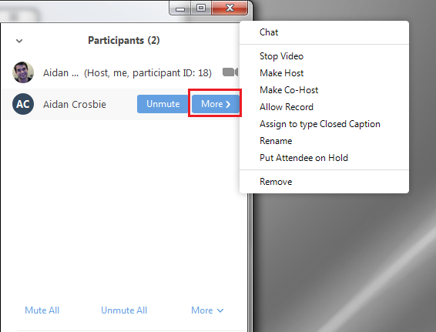
Manage Participants
Click “More” for individual participant controls
Click “Mute All” to silence any disruptions
Tip:
You can promote one participant to “Co-Host” if you want to give your TA or support person extra permissions to manage your meeting.
Notes:
Include slide on how to do this?

Slide 28
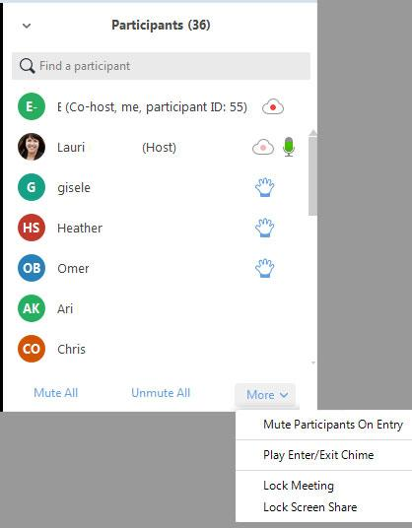
Manage Meeting Settings
Click on “More” for advanced meeting settings
Tip:
You can turn off the enter/exit chime to prevent disruptions after class begins.

Slide 29
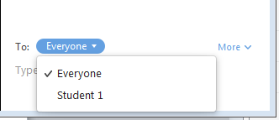
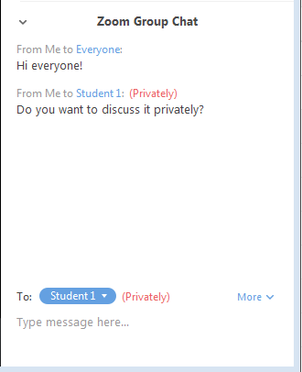
How to chat
1. Select whether you want to type to “Everyone” or an individual
2. Type your message and hit enter to send
Tip:
Be sure to select “Everyone” again if you want to type to the entire meeting room.

Slide 30
Meeting layouts & screen sharing

Slide 31
Meeting Layouts
Gallery View
Grid of participant webcams
Participants
Chat
Meeting Controls

Slide 32
Meeting Layouts
Speaker View
Thumbnails of participants webcams
Participants
Speaker on Webcam
Chat
Meeting Controls

Slide 33
Meeting Layouts
Screen Share
Meeting Controls
Thumbnails of participant webcams
Screen Share
Participants
Chat

Slide 34
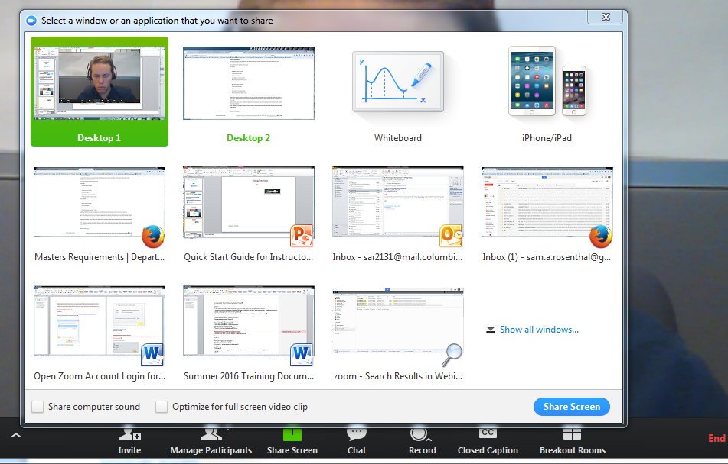
How to share your screen
2. Select either Desktop or Application
3. Click
Share Screen
Tip:
Check the “Share computer sound” box if you want to share audio from a YouTube video.
1. Click
Share Screen

Slide 35
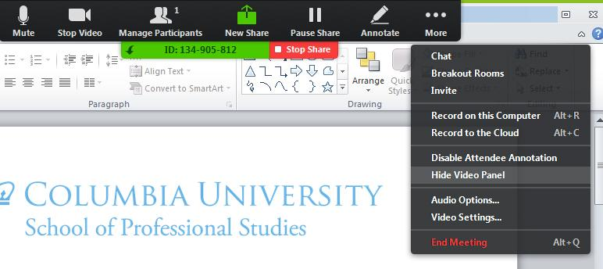
Host Controls on top in Screen Share
Tip:
When in screen share mode your Host controls move to the top of the screen. Click on “More” to access the Chat and other options.

Slide 36
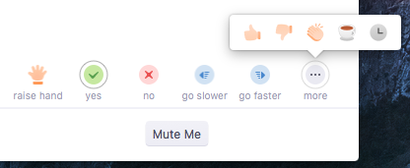
How can attendees participate?
Raise hand and other nonverbal responses
Start/Stop
Mic and Cam
See Participants
Share Screen
(If granted by Host)
Chat
Record
(If granted
by Host)

Slide 37
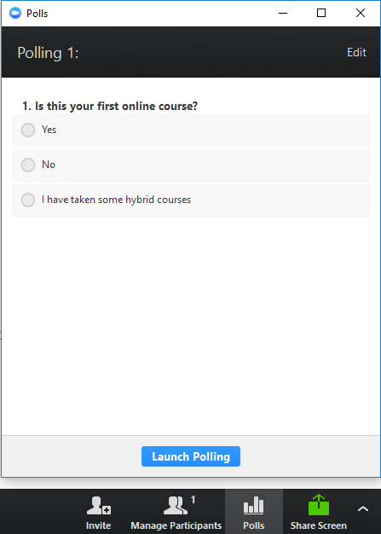
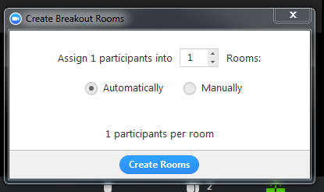
Polls and Breakouts

Slide 38
Polls
1. Click Edit to create poll questions and answers
Tip:
If you don’t see Polls on your Host controls then you either need to update your Zoom version or activate Polls in your Zoom settings.
2. Click Launch Polling to
share with participants

Slide 39
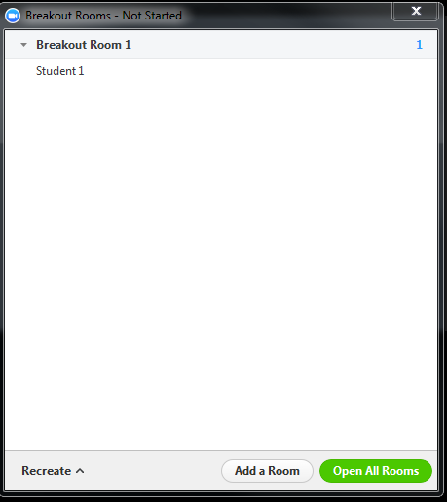
Breakouts
1. Click Breakout Rooms
2. Select the number of breakout rooms
3. Click Create Rooms
4. Click Open All Rooms

Slide 40
Breakouts and Host Rights
Control of the Breakout Rooms is limited to the meeting Host.
In breakout rooms, only the host can:
See the breakout button in the meeting controls
Set up breakouts and distribute participants
Open the breakout rooms
Move between breakout rooms
Move other participants between breakout rooms
Receive help messages from breakout room members
Send a message to all breakout room participants
End breakout rooms
Discuss who should have the host role during breakouts with your Webinar Support. Often, faculty give Webinar Supports the host role for the entire class session and have them manage breakouts. Your Webinar Support can help you devise a plan for your breakout sessions during your preflight meeting.

Slide 41
Granting Host Rights to your Webinar Support
Zoom meetings can only have one host at a time. You can hand over host rights to your Webinar Support as needed, and they can give those rights back to you.
2. Click “Make Host”
1. Click “More” for individual participant controls
Tip:
While host, your Webinar Support can give you co-host rights to enable you to see raised hands and manage participants

Slide 42
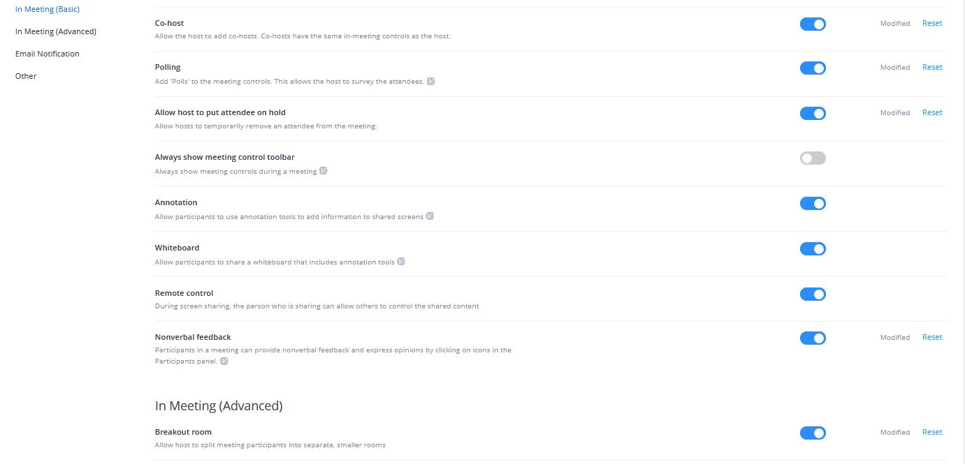
Advanced Meeting Settings
If you do not see options such as Polling, Breakouts, or other advanced features in your Zoom meeting, then you may need to log into your account settings and turn those features on. Log in here: https://columbiauniversity.zoom.us/profile/setting

Slide 43
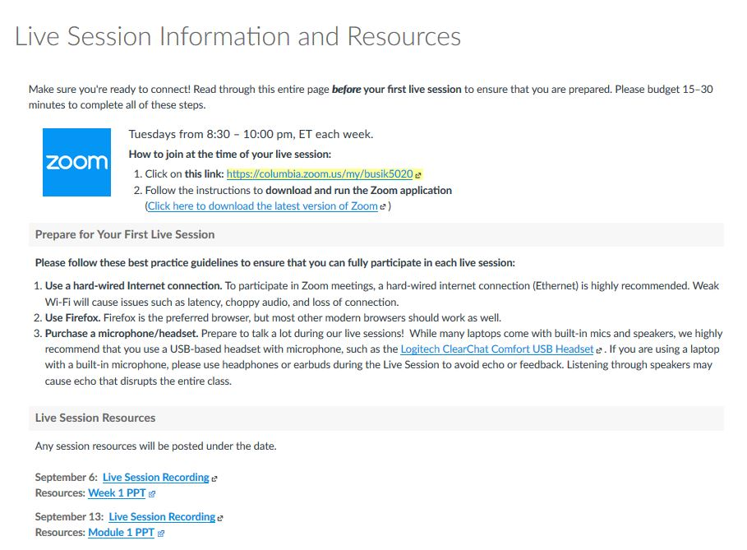
Recordings

Slide 44
Finding resources after a session: Class slides
Recordings and resources are uploaded by the Webinar Support to the
“Class Session Information
and Resources” page

Slide 45
Live Session Support

Slide 46
Ways to get support
During a session
Outside of a session
Chat privately with your Webinar Support person
Join a test meeting:
https://zoom.us/test
Submit a Request
Cusps.zendesk.com

Slide 47
During a live session:
Webinar Supports:
Troubleshoot with users
in group and private chat
Manage the technical aspects of running the live session
Route course content
and grading questions
to the faculty or facilitator
Route students to the helpdesk for further support

Slide 48
Questions?
?

Slide 49
Tips for Increasing Interactivity
Lecture
Foreground student experience
Compelling content, dynamic visuals and interactive moments
Chat
Promote reflective dialogue
Moderate and highlight relevant questions from students
Demo
Share your screen
Highlight/draw tool to clarify a point
Real-time walkthrough of problems
Discussion
Get students on the mic
Let students guide discussion
Breakout rooms for more productive conversations
Polls
Guided polling to spark discussion
Reward students for interacting

