Slide 1
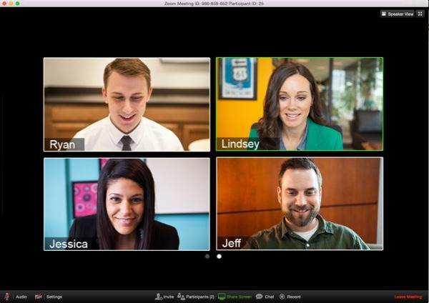
Welcome to your first Online Session
Notes:
What is Zoom?
Zoom is a cloud-based HD video-conferencing tool. Zoom allows for the instructor and students to meet in real-time via webcam and audio. Instructors can screen share content during their lecture or invite students on mic and webcam for discussion. Zoom allows for participation via features like raise hand, chat, audio, and in some classes polling questions and breakouts.
Zoom offers:
Ease of use: Download Zoom, join your meeting, turn on your mic and webcam
Quality: Zoom allows for HD webcam video, clear Audio, and crisp Screen Share
Stability: The bandwidth used by Zoom will be optimized for the best experience based on the participants’ network. It will automatically adjust for 3G, WiFi or Wired environments.

Slide 2
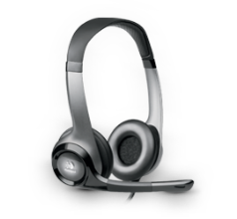
Best practice tips before we begin…
We recommend: Because:
A hard-wired connection
Poor wifi causes:
choppy audio
disconnection
A modern web browser
Out of date
browsers may cause performance issues
A headset or headphones
Using computer
speakers may
cause echo
Notes:
Zoom works well on wifi because it optimizes performance based on the user’s network. However, as the main Host for the meeting it is best to be connected via Ethernet to prevent any performance issues.
It is best to use a supported operating system and modern web browser when hosting a Zoom meeting. Supported browsers include: Firefox, Chrome, Safari5+, and IE7+
Always use a headset when in a Zoom meeting to avoid audio feedback. Otherwise, other people in the meeting will experience a strong echo when you speak (you will not necessarily hear it but others will).

Slide 3
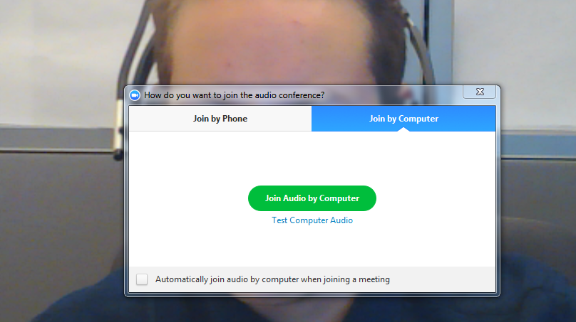
At the start of class, activate your microphone:
When you enter the class you will see this pop-up appear:
Click to Join or Test your Computer Audio

Slide 4
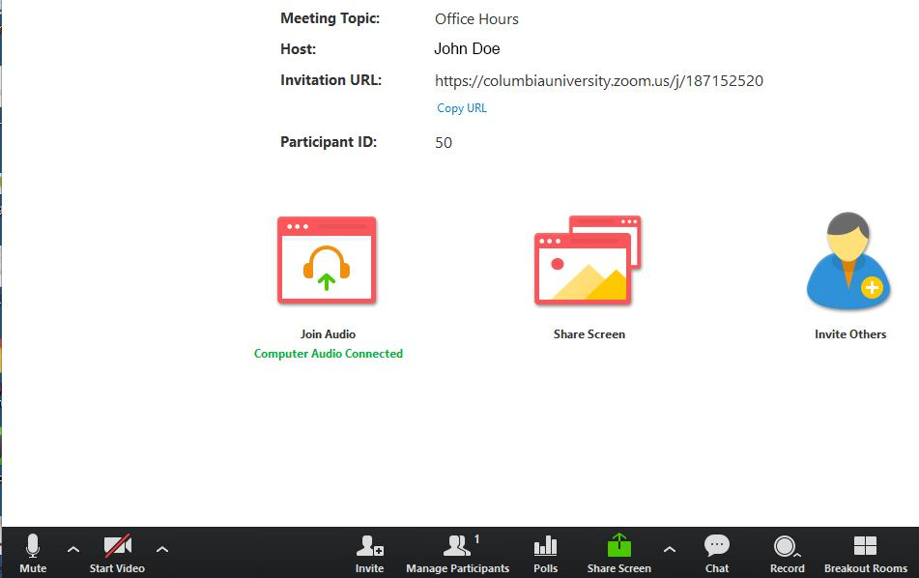
Activate your webcam
Your webcam should activate automatically, but if it does not then you can
click on the Video icon in the lower left of your screen:
Click
“Start Video”
Tip:
Click on the up arrows to access audio and video settings

Slide 5
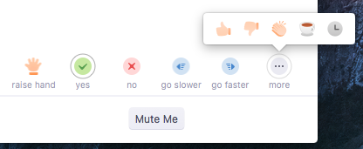
Participant controls:
Raise hand and other nonverbal responses
Start/Stop
Mic and Cam
See Participants
Share Screen
(If granted by Host)
Chat
Record
(If granted
by Host)

Slide 6
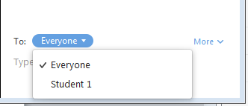
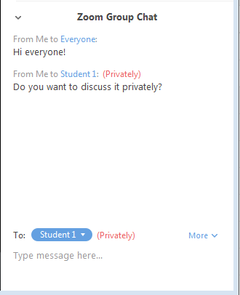
How to chat
1. Select whether you want to type to “Everyone” or an individual
2. Type your message and hit enter to send
Tip:
Be sure to select “Everyone” again if you want to type to the entire meeting room.

Slide 7
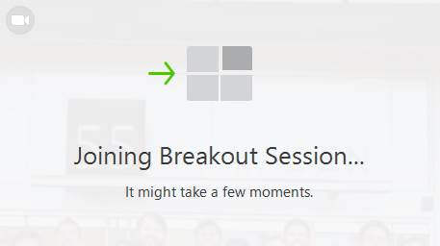
Join Breakouts
1. Clicking “Join Session” will send you to your breakout
2. Ask for Help if you need to get in touch with the Host

Slide 8
Ways to get support
During a session
Outside of a session
Chat privately with your Webinar Support person
Join a test meeting:
https://zoom.us/test
Submit a Request
Cusps.zendesk.com

Slide 9
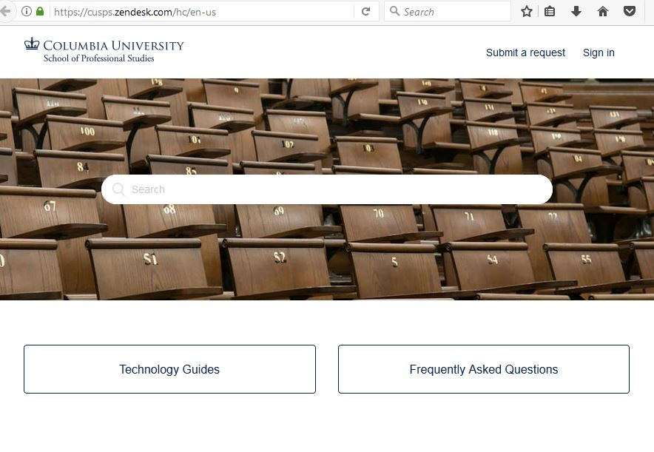
Submit a Helpdesk Request

